Slide 1

AWS Training
23/07/2024
Axel Tifrani

Slide 2
Agenda
Section 1 : Introduction to aws cloud
Section 2 : AWS Network
Section 3 : AWS Security
Section 4 : AWS Storage services
Section 5 : AWS Processing Services
Section 6 : AWS Databases Services
Section 7 : AWS Analytic Services
Section 8 : AWS ML & IA Services

Slide 3
Introduction to AWS Cloud
The AWS global infrastructure
The AWS Shared responsibility model
The AWS princing fundamentals

Slide 4


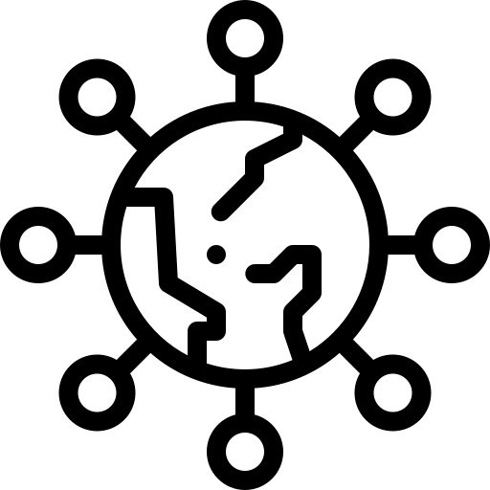

Introduction to AWS Cloud
Cloud computing is the delivery of computing services: Servers, Storage, Databases, Networking, Software, Analytics, Intelligence and more, over the internet (The cloud) to offer faster innovation, flexible resources and economies of scale.
You typically pay only for cloud services you user, helping lower your operating costs, run your infrastructure more efficiently, and scale as your business needs change.
Compute
Storage
Network
Applications

Slide 5
Introduction to AWS Cloud
The AWS Global Infrastructure is made up of:
AWS Regions
A region is a geographical area
Each region consists of 2 or more availability zones
Isolated from other AWS Regions
Availability Zones
Availability Zones are physically separate and isolated from each other
AZs span one or more data centers
Each AZ is designed as an independent failure zone
Local Zones
AWS Local Zones place compute, storage, database, and other select
AWS services closer to end-users
Extension of an AWS Region where you can run your latency sensitive applications

Slide 6
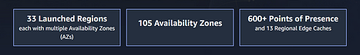
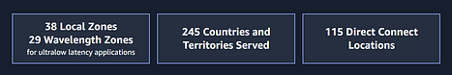
Introduction to AWS Cloud
AWS Global Infrastructure Map : https://aws.amazon.com/about-aws/global-infrastructure/
The AWS Cloud spans 105 Availability Zones within 33 geographic regions around the world, with announced plans for 15 more Availability Zones and 5 more AWS Regions in Germany, Malaysia, Mexico, New Zealand, and Thailand.
In addition, AWS has 38 Local Zones and 29 Wavelength Zones for ultralow latency applications, it served 245 Countries and Territories and it has 115 Direct Connect Locations.

Slide 7

Introduction to AWS Cloud

Slide 8
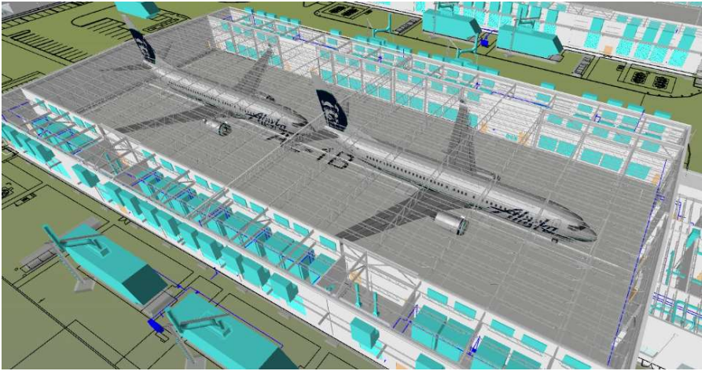
Introduction to AWS Cloud

Slide 9

Introduction to AWS Cloud

Slide 10
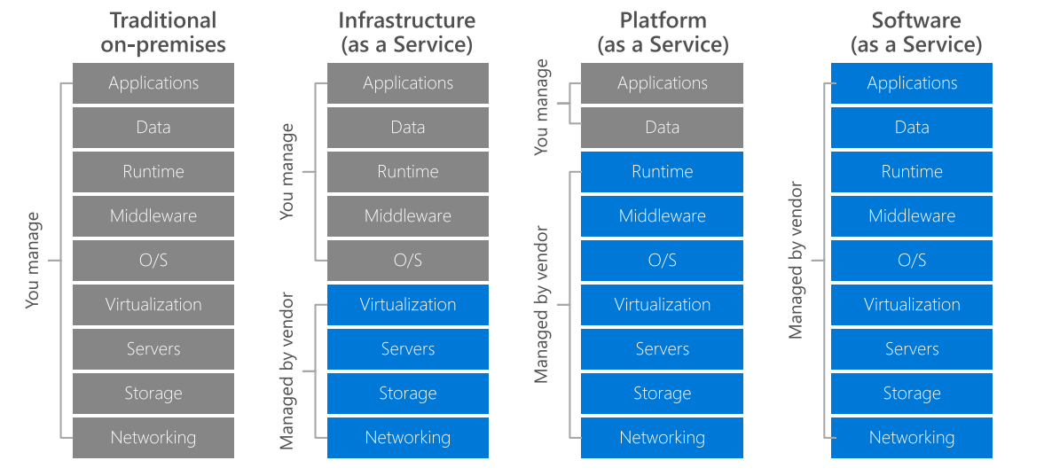
Introduction to AWS Cloud

Slide 11
Introduction to AWS Cloud
IAAS: Infrastructure As A Service is offered by platforms such as Amazon EC2. You buy time on these services, and install and configure your own software, such as a Hadoop cluster or NoSQL database.
Using IaaS gives you a broad choice of cloud supplier, the full control of your software life cycle, but you'll be responsible for deploying, managing and maintaining your clusters.
PAAS: Beyond IaaS, several cloud services provide application layer support for big data work. Sometimes referred to as managed solutions, or Platform As A Service such as Amazon Redshift, these services remove the need to configure or scale things such as databases or processing engine, reducing your workload and maintenance burden.
SAAS: Software As A Service such as Snowflake integrates many of the functionalities and benefits of IaaS and PaaS and additional capabilities like data sharing to deliver advanced analysis of large data sets

Slide 12
Introduction to AWS Cloud
The AWS shared responsibility model defines customer/AWS responsibilities:
AWS are responsible for “Security of the Cloud”
AWS is responsible for protecting the infrastructure that runs all of the services offered in the AWS Cloud
This infrastructure is composed of the hardware, software, networking, and facilities that run AWS Cloud services
Customers are responsible for “Security in the Cloud”
For EC2 this includes network level security, operating system patches and updates, IAM user access management, and client and server-side data encryption

Slide 13
Introduction to AWS Cloud
Fundamentals of pricing:
Compute – CPU/RAM and duration
Storage – quantity of data stored or allocated
Outbound data transfer – data leaving an AWS Region
AWS Pricing Calculator, Estimate the cost of your aws solution architecture. https://calculator.aws

Slide 14
AWS Security
AWS Identity and Access Management (IAM)
IAM Users and groups
IAM Roles and Policy

Slide 15
AWS Security - IAM
IAM (Identity and Access Management) is where you manage your AWS users and their access to AWS accounts and services.
IAM is commonly used to manage:
Users
Groups
Access Policies
Roles
Note: The user created when tou created the AWS account is called the « root » user.
By default, the root user has full administrative rights and access to every part of the account.
By default, any new users you create in the aws account are created with no access to any aws services
For all users (besides the root user), permissions must be given that grant access to AWS services

Slide 16
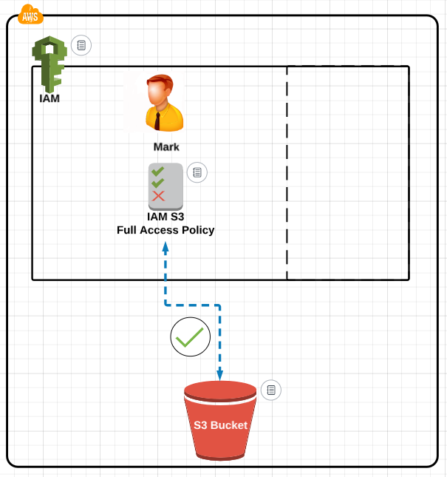
AWS Security - IAM
Create a user Mark
The user will be create without any permissions
Grant permissions to the user Mark
Attach a S3 full access policy to the user Mark

Slide 17
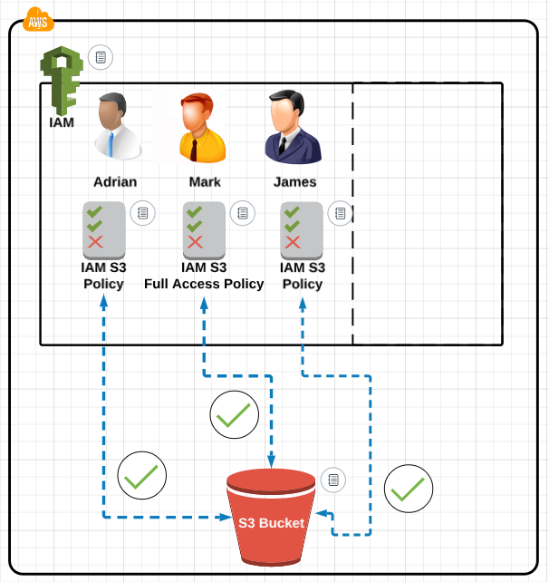
AWS Security - IAM
You can create multiple users at once
Adrian and James users will be created without any permissions
Attach an exsiting S3 policy to allow Adrian and James access to S3 bucket,

Slide 18
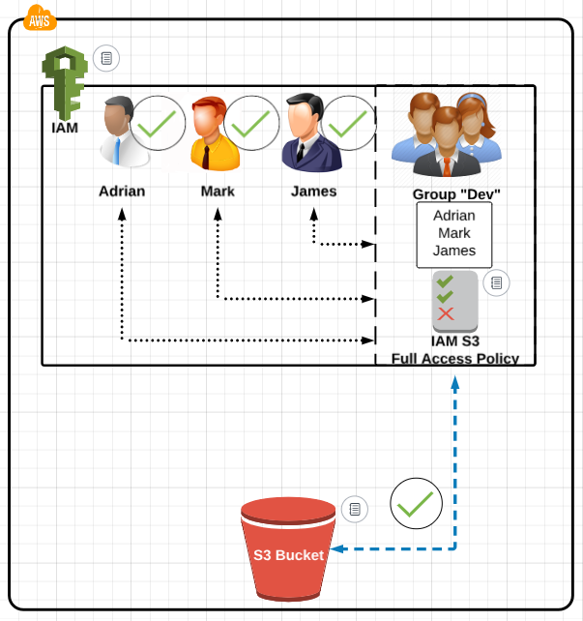
AWS Security - IAM
Create a group called « Dev »
Add users to the group
Attach IAM S3 policy to the group

Slide 19
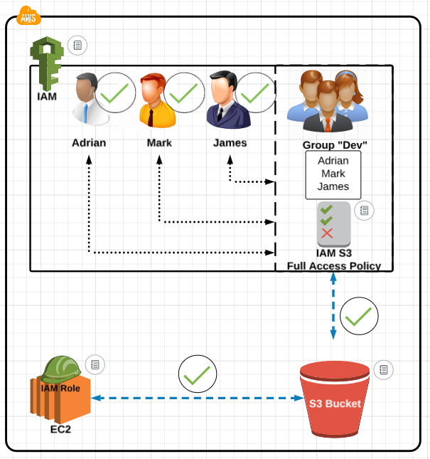
AWS Security - IAM
Suppose we have EC2 instance that need access to files wthin S3 bucket
We cannot attach IAM policy to the EC2
We need to create IAM role
Attach the IAM policy to the role to allow EC2 to access the S3 bucket.

Slide 20
AWS Security - IAM

Slide 21
AWS Network
AWS Virtual Private Cloud (VPC)
AWS public and private Subnets
AWS Security Groups and Network ACLs
AWS public and private IP addresses

Slide 23
AWS Storage services
AWS Elastic Bloc Store (EBS) and Instance Store
AWS Elastc File System (EFS)
AWS Simple Storage Service (S3)

Slide 24
AWS Processing Services
AWS Elastic Cloud Compute (EC2)
AWS Batch
AWS Lambda
AWS EMR
AWS Glue ETL
AWS ECS and Fargate

Slide 25
AWS Databases Services
AWS Relational Database Service (RDS)
AWS Aurora
AWS DynamoDB
AWS OpenSearch

Slide 26
AWS Analytic Services
AWS Redshift
AWS Spectrum
AWS Glue Catalogue
AWS Athena

Slide 27
AWS ML & IA Services
AWS SageMaker
AWS BedRock

